Slide 1
C Language 스터디 1주차

Slide 2
목표:
Tutorial introduction
Types, operators, and expressions

Slide 3
Tutorial introduction
Get start
Variables and Arithmetic expression
For, While statements
Constants
다른 항목을 공부하기에 필수적인 지식

Slide 4
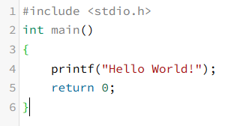
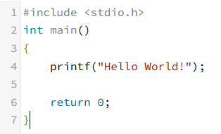
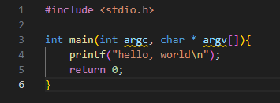
Get start

Slide 5
Get start

Slide 6
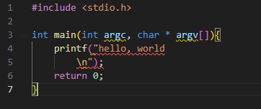
Error code

Slide 7
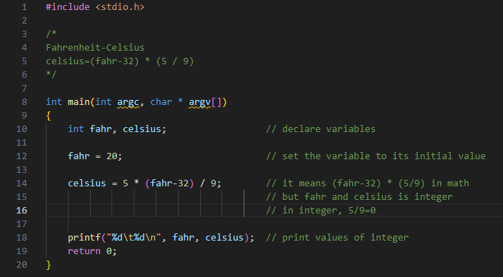
Variables and Arithmetic expression

Slide 8
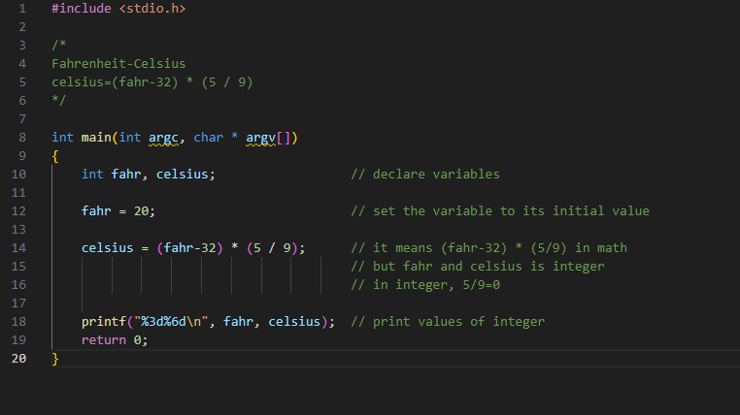
Variables and Arithmetic expression

Slide 9
Variables and Arithmetic expression
Error code

Slide 10
Variables and Arithmetic expression

Slide 11
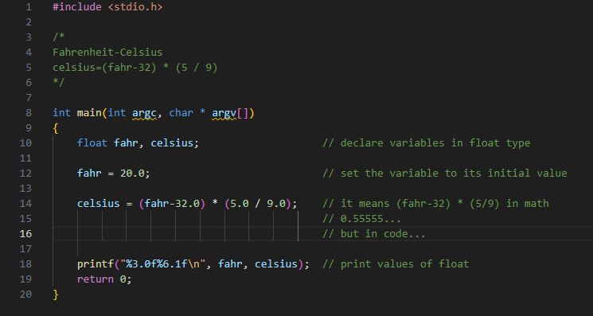
Variables and Arithmetic expression

Slide 12
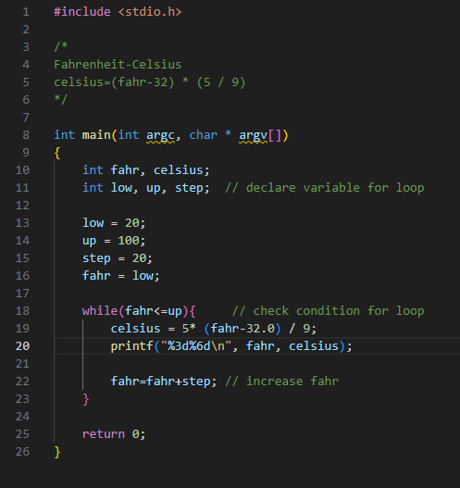
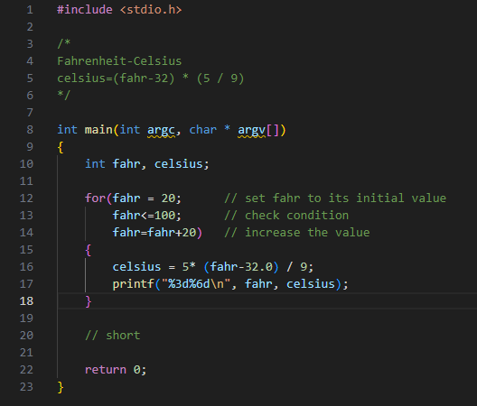
For and While statements

Slide 13
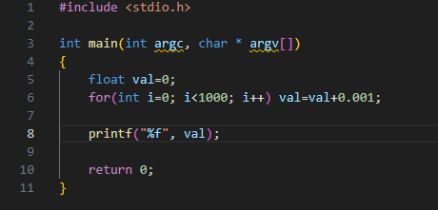
번외 왜 루프에서 float을 쓰지 않았는가?

Slide 14
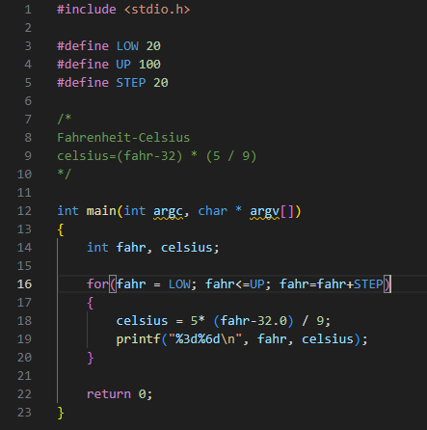
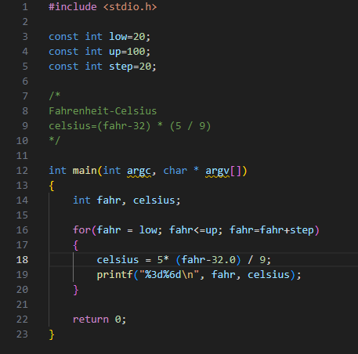
Constants

Slide 15
Types, operators, and expressions
Naming
Types and sizes
Constants and enumeration
Type conversion
Operators
Assignment operator
Conditional operator
Bitwise Operators

Slide 16
Naming
Being made up of Letters, digits.
Starting with Letters.
Recommendation:
Don’t start with Underscore
Less than 31 character
Letters | Digits
A-Z a-z _(underscore) | 0-9

Slide 17
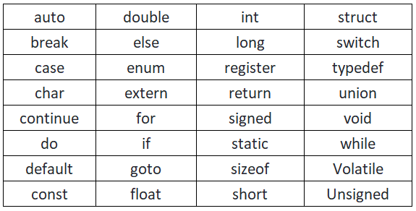
Naming
Reserved Word

Slide 18
Types and sizes
char | Capable of holding one character in ‘local’
int | Natural size of integer on ‘local’
float | single precision floating point
double | double precision floating point

Slide 19
Types and sizes

Slide 20
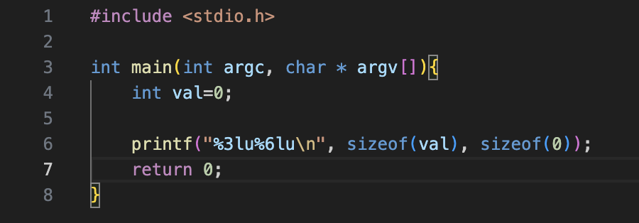
번외: sizeof

Slide 21
번외: unsigned, signed
Unsigned
0000 0000 = 0
0000 0001 = 1
…
1111 1111 = 255
Signed
1000 0000 = -128
1000 0001 = -127
…
0000 0000 = 0
…
0111 1111 = 127

Slide 22
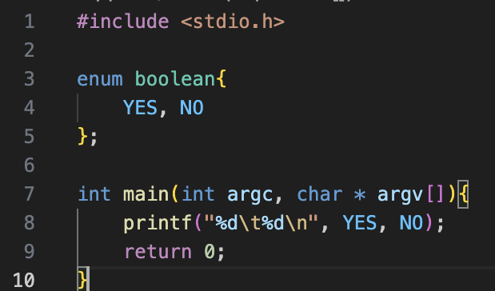
Constants and enumeration

Slide 23
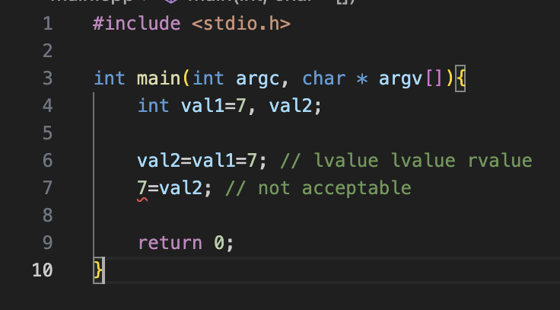
번외: lvalue, rvalue

Slide 24
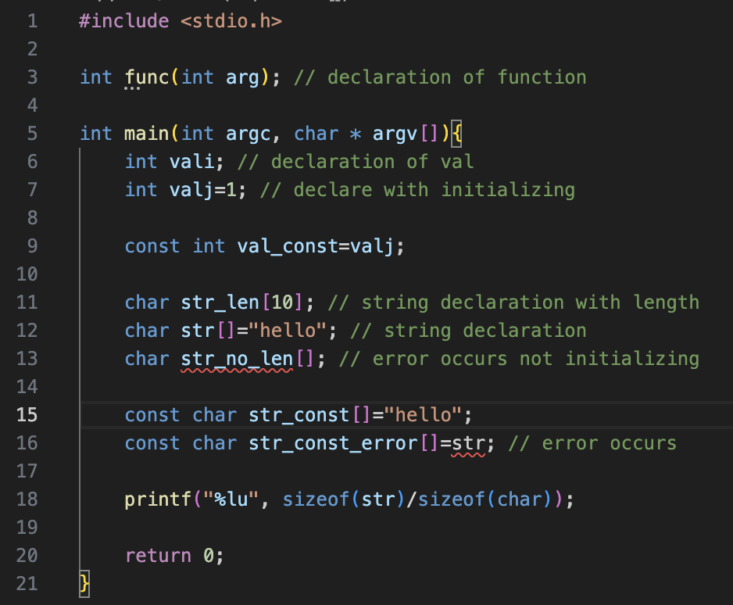
Declaration

Slide 25
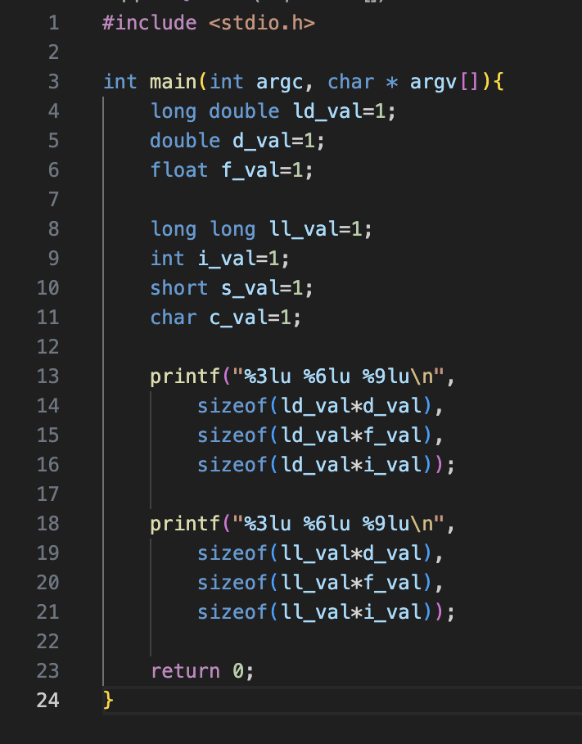
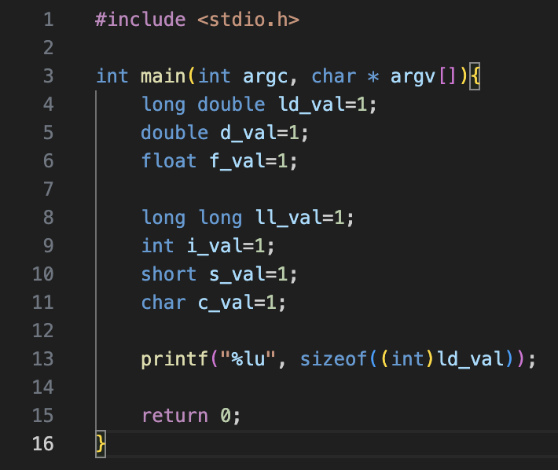
Type conversion

Slide 26
Operators
Unary | ++, --, +, -, sizeof, &, *, ~, !
Relational and Logical | ==, !=, <, >, <=, >=, &&, ||
Arithmetic | +, -, *, /, %
Assignment | =, +=, -=, *=, /=, %=, &=, |=, ^=, <<=, >>=,
Bitwise | &, ^, |, <<, >>
Conditional expression | ?

Slide 27
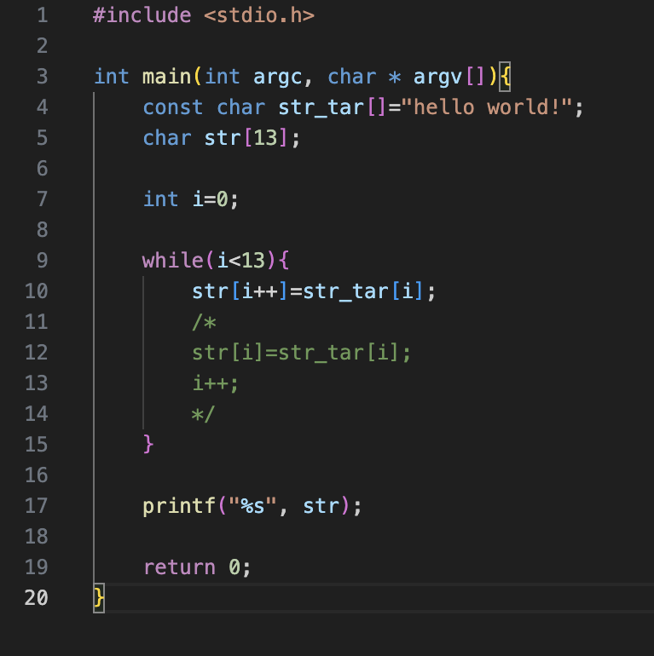
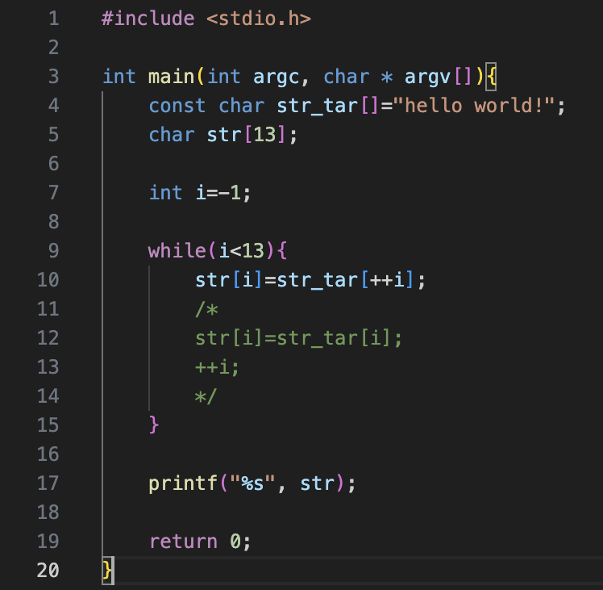
Unary Operators
What's different?

Slide 28
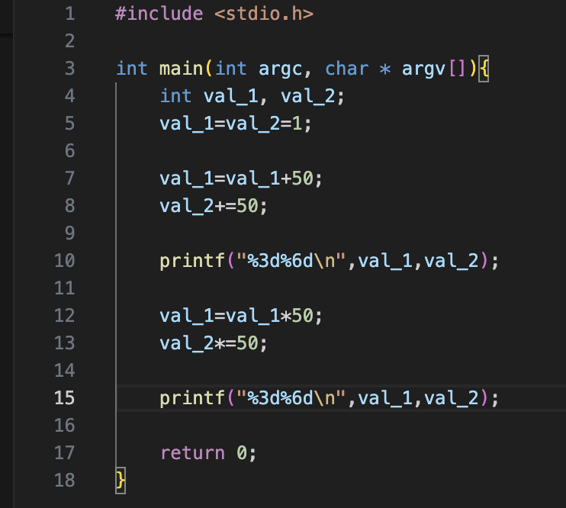
Assignment operation
Expression

Slide 29
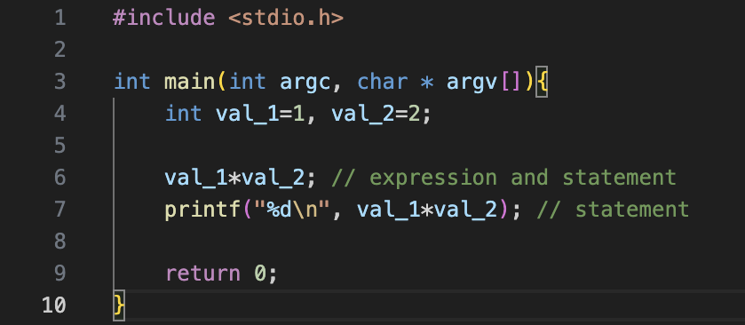
번외: expression과 statement
statement
expression

Slide 30
Bitwise operators
and | & | 상응하는 비트에 대해서 논리 and 연산
or | | | 상응하는 비트에 대해서 논리 or 연산
xor | ^ | 상응하는 비트에 대해서 논리 xor 연산
not | ~ | 모든 비트를 반대로

Slide 31
Bitwise Example
val_1 = 1010 1010(2)
val_2 = 1010 0101(2)
val_1 & val_2 = 1010 0000(2)
val_1 | val_2 = 1010 1111(2)
val_1 ^ val_2 = 0000 1111(2)
~val_1 = 0101 0101(2)

Slide 32
Bitwise shift operation
<< | increases bite address by expr2
>> | decreases bite address by expr2
<<= | expr1 = expr1 << expr2
>>= | expr1 = expr1 >> expr2

Slide 33
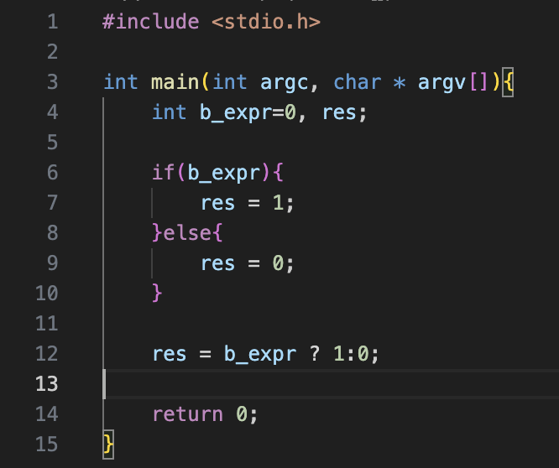
Conditional expression
Expression
and
Statement

Slide 34
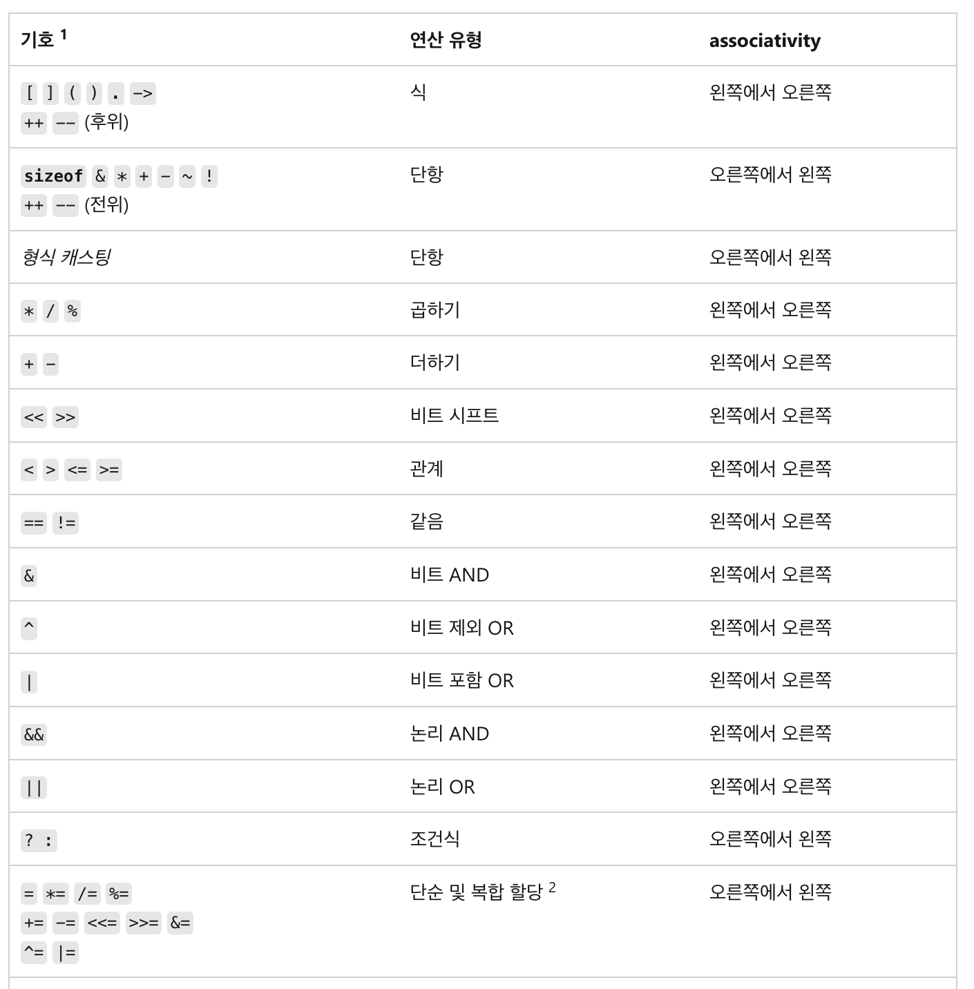
Precedence and Order of evaluation

